Slide 1
18CSC202J - OBJECT ORIENTED DESIGN AND PROGRAMMING
UNIT V
SESSION 1
TOPIC:STL CONTAINERS
SEQUENCE CONTAINNER

Slide 2
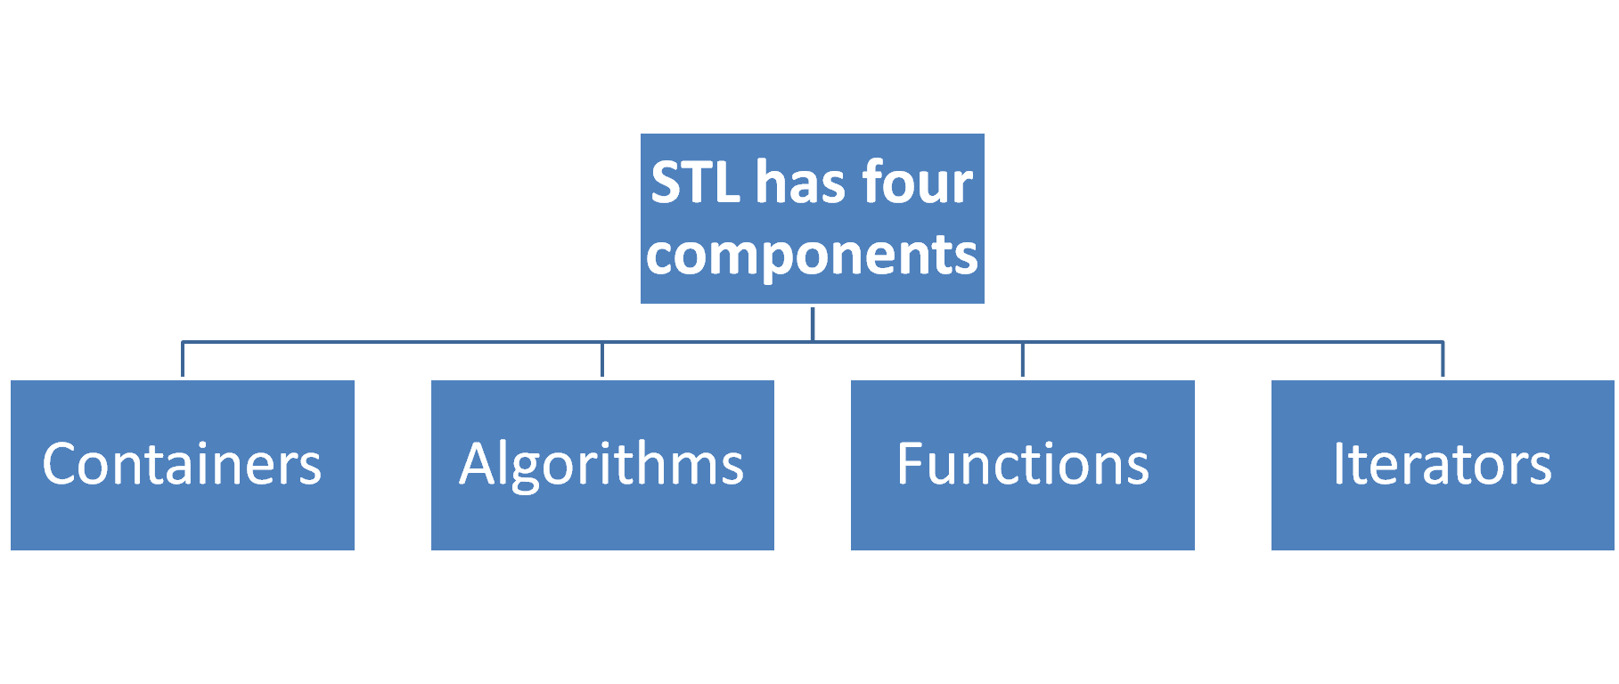

Slide 3
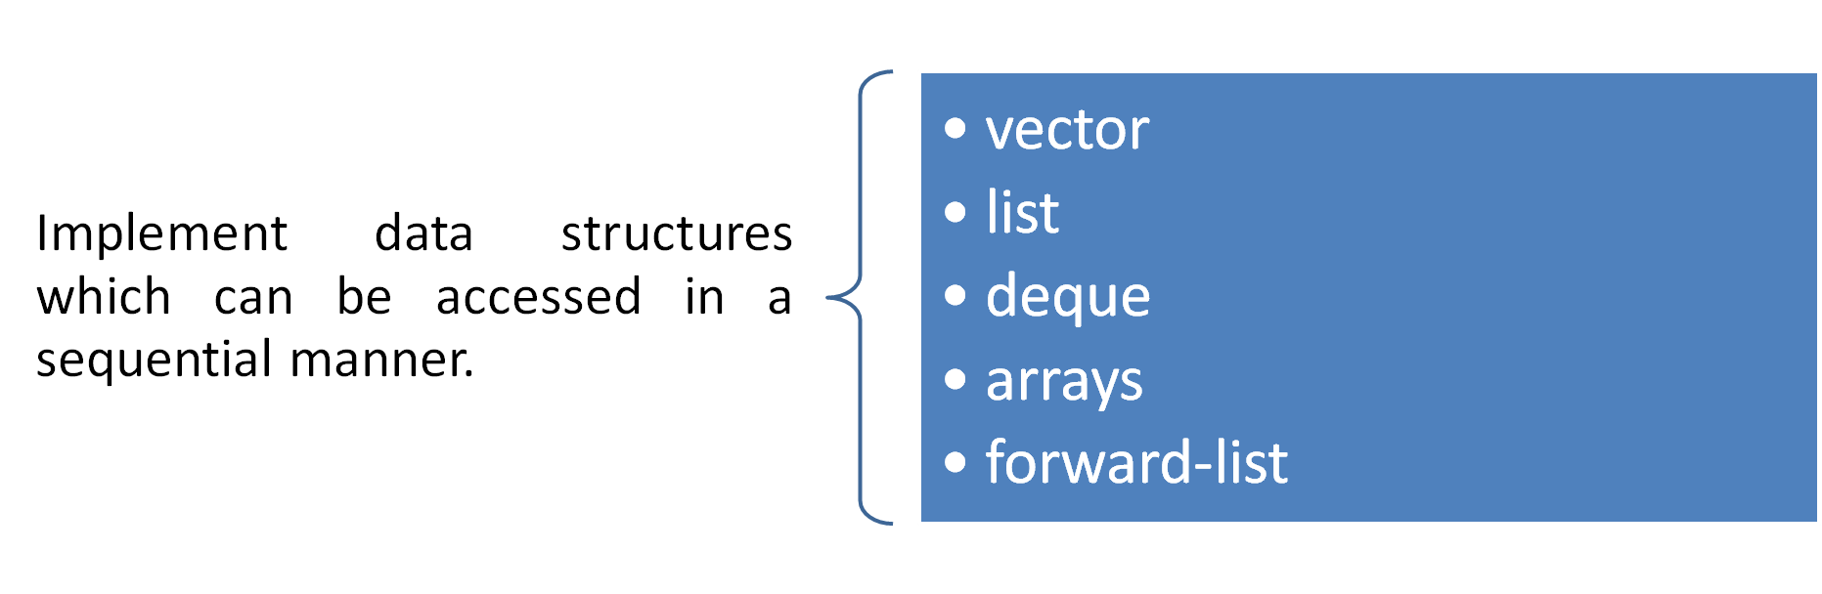
Sequence Containers

Slide 4
Sequence Containers: Deque
Double ended queues are sequence containers with the feature of expansion and contraction on both the ends.
They are similar to vectors, but are more efficient in case of insertion and deletion of elements. Unlike vectors, contiguous storage allocation may not be guaranteed.
Double Ended Queues are basically an implementation of the data structure double ended queue. A queue data structure allows insertion only at the end and deletion from the front.
This is like a queue in real life, wherein people are removed from the front and added at the back. Double ended queues are a special case of queues where insertion and deletion operations are possible at both the ends.
The functions for deque are same as vector, with an addition of push and pop operations for both front and back.

Slide 5
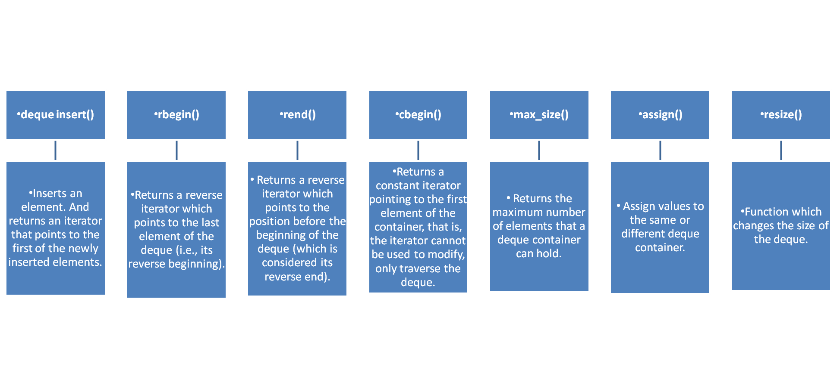
Methods of Deque

Slide 6
#include <iostream>
#include <deque>
using namespace std;
void showdq(deque <int> g)
{
deque <int> :: iterator it;
for (it = g.begin(); it != g.end(); ++it)
cout << '\t' << *it;
cout << '\n';
}
int main()
{
deque <int> gquiz;
gquiz.push_back(10);
gquiz.push_front(20);
gquiz.push_back(30);
gquiz.push_front(15);
cout << "The deque gquiz is : ";
showdq(gquiz);
cout << "\ngquiz.size() : " << gquiz.size();
cout << "\ngquiz.max_size() : " << gquiz.max_size();
cout << "\ngquiz.at(2) : " << gquiz.at(2);
cout << "\ngquiz.front() : " << gquiz.front();
cout << "\ngquiz.back() : " << gquiz.back();
cout << "\ngquiz.pop_front() : ";
gquiz.pop_front();
showdq(gquiz);
cout << "\ngquiz.pop_back() : ";
gquiz.pop_back();
showdq(gquiz);
return 0;
}
OUTPUT:
The deque gquiz is : 15 20 10 30
gquiz.size() : 4
gquiz.max_size() : 4611686018427387903
gquiz.at(2) : 10
gquiz.front() : 15
gquiz.back() : 30
gquiz.pop_front() : 20 10 30
gquiz.pop_back() : 20 10

Slide 7
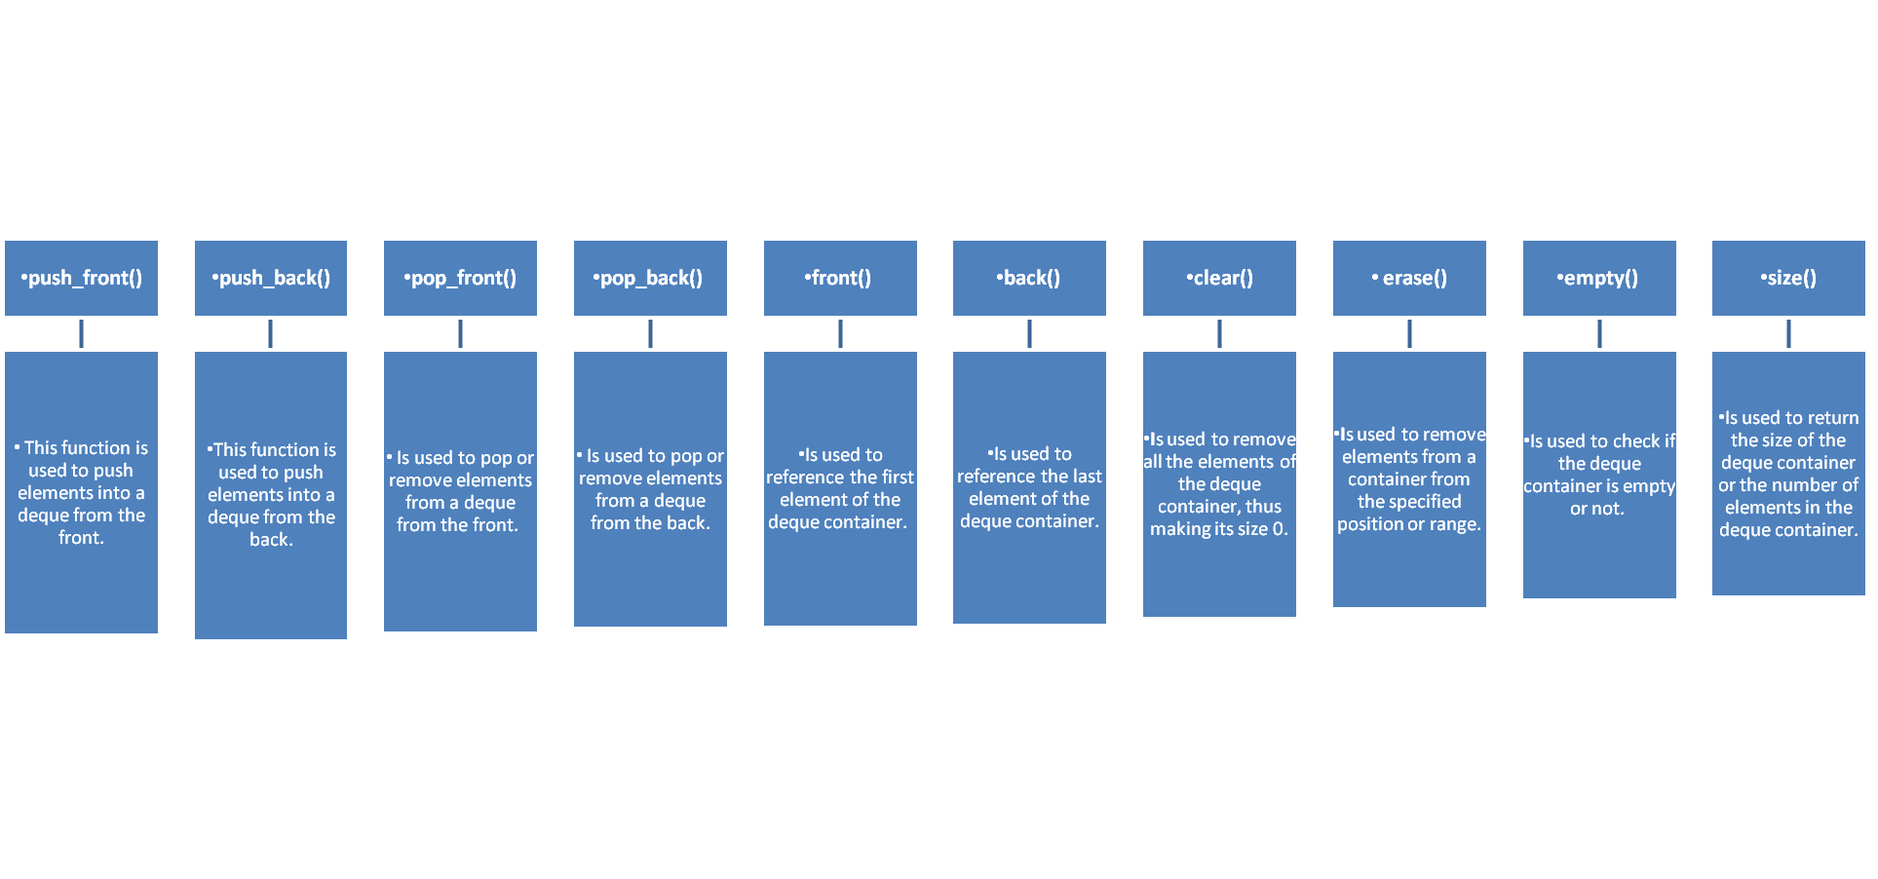
Methods of Deque

Slide 8
Sequence Containers: Array
The introduction of array class from C++11 has offered a better alternative for C-style arrays. The advantages of array class over C-style array are :-
Array classes knows its own size, whereas C-style arrays lack this property. So when passing to functions, we don’t need to pass size of Array as a separate parameter.
With C-style array there is more risk of array being decayed into a pointer. Array classes don’t decay into pointers
Array classes are generally more efficient, light-weight and reliable than C-style arrays.

Slide 9
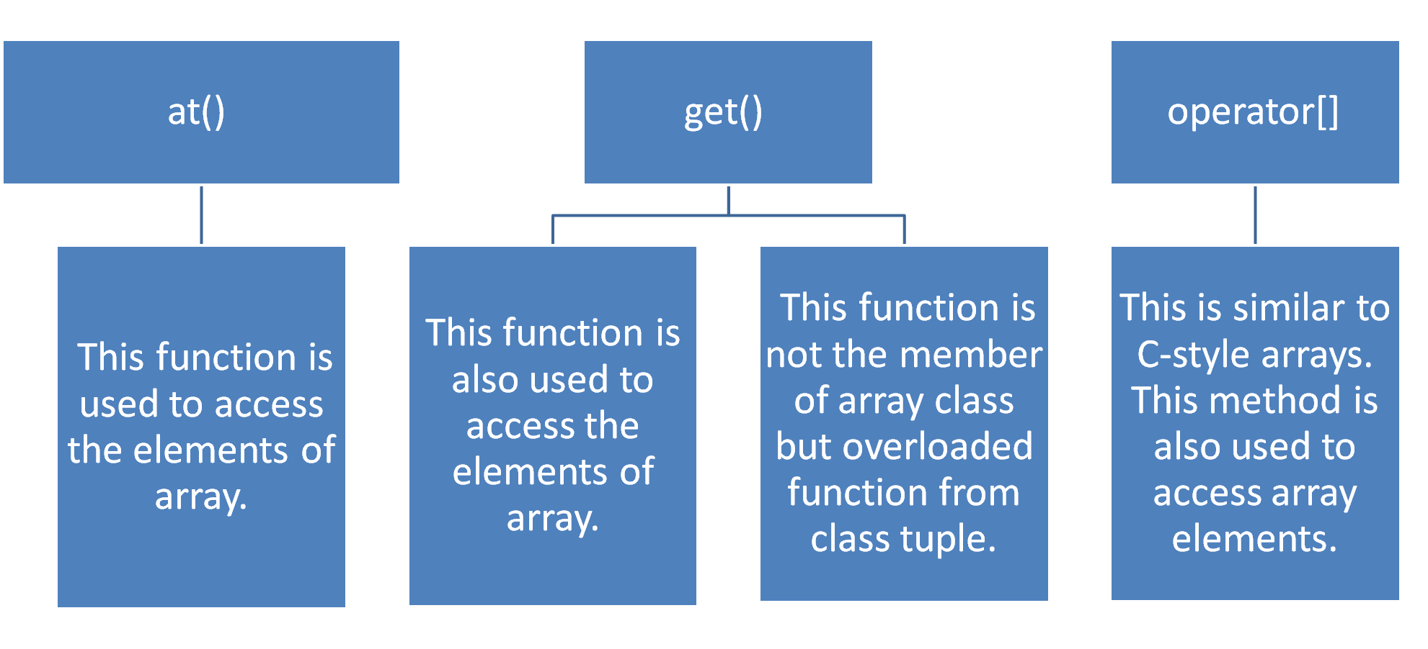
Operations on array

Slide 10
// // C++ code to demonstrate working of array, to() and get()
#include<iostream>
#include<array> // for array, at()
#include<tuple> // for get()
using namespace std;
int main()
{
// Initializing the array elements
array<int,6> ar = {1, 2, 3, 4, 5, 6};
// Printing array elements using at()
cout << "The array elements are (using at()) : ";
for ( int i=0; i<6; i++)
cout << ar.at(i) << " ";
cout << endl;
// Printing array elements using get()
cout << "The array elements are (using get()) : ";
cout << get<0>(ar) << " " << get<1>(ar) << " ";
cout << get<2>(ar) << " " << get<3>(ar) << " ";
cout << get<4>(ar) << " " << get<5>(ar) << " ";
cout << endl;
// Printing array elements using operator[]
cout << "The array elements are (using operator[]) : ";
for ( int i=0; i<6; i++)
cout << ar[i] << " ";
cout << endl;
return 0;
}
Output:
The array elements are (using at()) : 1 2 3 4 5 6
The array elements are (using get()) : 1 2 3 4 5 6
The array elements are (using operator[]) : 1 2 3 4 5 6

Slide 11
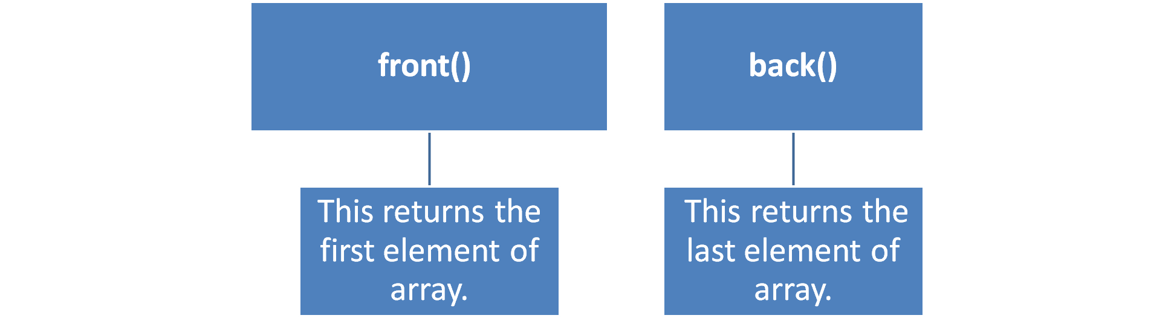
Operations on array

Slide 12
// C++ code to demonstrate working of front() and back()
#include<iostream>
#include<array> // for front() and back()
using namespace std;
int main()
{
// Initializing the array elements
array<int,6> ar = {1, 2, 3, 4, 5, 6};
// Printing first element of array
cout << "First element of array is : ";
cout << ar.front() << endl;
// Printing last element of array
cout << "Last element of array is : ";
cout << ar.back() << endl;
return 0;
}
Output:
First element of array is : 1
Last element of array is : 6

Slide 13
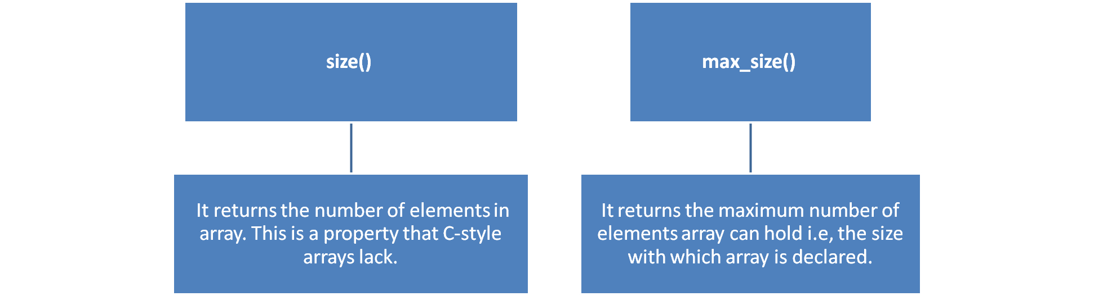
Operations on array

Slide 14
// C++ code to demonstrate working of size() and max_size()
#include<iostream>
#include<array> // for size() and max_size()
using namespace std;
int main()
{
// Initializing the array elements
array<int,6> ar = {1, 2, 3, 4, 5, 6};
// Printing number of array elements
cout << "The number of array elements is : ";
cout << ar.size() << endl;
// Printing maximum elements array can hold
cout << "Maximum elements array can hold is : ";
cout << ar.max_size() << endl;
return 0;
}
Output:
The number of array elements is : 6 Maximum elements array can hold is : 6

Slide 15
Operations on array

Slide 16
swap() :- The swap() swaps all elements of one array with other.
// C++ code to demonstrate working of swap()
#include<iostream>
#include<array> // for swap() and array
using namespace std;
int main()
{
// Initializing 1st array
array<int,6> ar = {1, 2, 3, 4, 5, 6};
// Initializing 2nd array
array<int,6> ar1 = {7, 8, 9, 10, 11, 12};
// Printing 1st and 2nd array before swapping
cout << "The first array elements before swapping are : ";
for (int i=0; i<6; i++)
cout << ar[i] << " ";
cout << endl;
cout << "The second array elements before swapping are : ";
for (int i=0; i<6; i++)
cout << ar1[i] << " ";
cout << endl;
// Swapping ar1 values with ar
ar.swap(ar1);
// Printing 1st and 2nd array after swapping
cout << "The first array elements after swapping are : ";
for (int i=0; i<6; i++)
cout << ar[i] << " ";
cout << endl;
cout << "The second array elements after swapping are : ";
for (int i=0; i<6; i++)
cout << ar1[i] << " ";
cout << endl;
return 0;
}

Slide 17
Output:
The first array elements before swapping are : 1 2 3 4 5 6
The second array elements before swapping are : 7 8 9 10 11 12 The first array elements after swapping are : 7 8 9 10 11 12
The second array elements after swapping are : 1 2 3 4 5 6

Slide 18
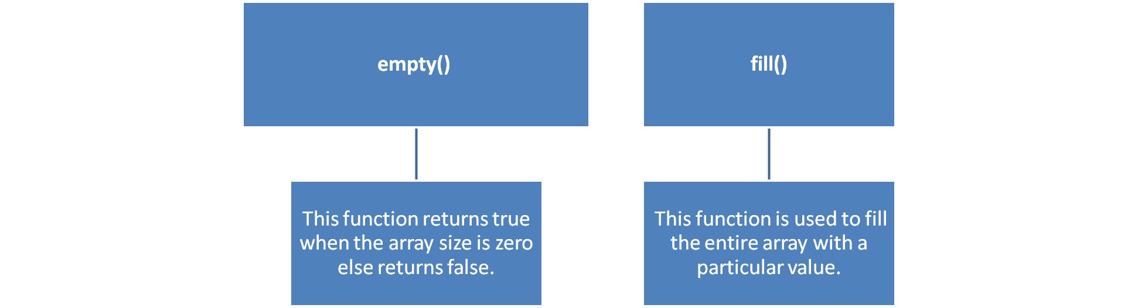
Operations on array

Slide 19
// C++ code to demonstrate working of empty() and fill()
#include<iostream>
#include<array> // for fill() and empty()
using namespace std;
int main()
{
array<int,6> ar; // Declaring 1st array
array<int,0> ar1; // Declaring 2nd array
ar1.empty()? cout << "Array empty":
cout << "Array not empty";
cout << endl; // Checking size of array if it is empty
// Filling array with 0
ar.fill(0);
// Displaying array after filling
cout << "Array after filling operation is : ";
for ( int i=0; i<6; i++)
cout << ar[i] << " ";
return 0;
}
Output:
Array empty
Array after filling operation is : 0 0 0 0 0 0

